Slide 1
AI-Based Early Warning System for Cardiovascular Disease Detection
AI-ML PBL REVIEW 4
Team Members:
P. Poojitha
T. Pallavi
Y. Gowthami
Rukmini
J. Rakshitha
Guide: Dr. Sudharsana Rao
Department of ECE, KLEF

Slide 2
Literature Survey
Early models like Logistic Regression achieved 77–83% accuracy (Detrano et al., 1989).
SVM improved accuracy to 84.1% Random Forest achieved 91%
Key clinical parameters: Chest Pain Type, Cholesterol, ST Depression, Heart Rate.
Gap identified: High accuracy with interpretability for medical trust.

Slide 3
Dataset Selection
• Dataset: Public Heart Disease Dataset (Cleveland-based, 1,025 records, 14 attributes).
• Features: Age, Sex, Chest Pain Type, BP, Cholesterol, Heart Rate, Exercise induced angina, ECG,Sugar, Thalassemia test result, Colured Artiries, Old peak, Slope,
• Target: Heart Disease (1 = Yes, 0 = No).
• Balanced Data: 526 positive & 499 negative.

Slide 4
Model Selection
• Explored Models: Logistic Regression, SVM, Random Forest.
• Chosen Model: Random Forest Classifier.
• Reasons:
  Handles nonlinear data.
Prevents overfitting.
- Provides feature importance for interpretability.
• Tuned Parameters: n_estimators=100, max_depth=8, criterion='gini'.

Slide 5
Results and Evaluation
• Accuracy: 92.3%
• Precision: 91.5%
• Recall: 93.0%
• F1-Score: 92.2%
• ROC-AUC: 0.90
• Top 5 Features: Chest Pain Type, ST Depression, Max Heart Rate, Slope, Age.

Slide 6
Future Scope
1. Integration with IoT Devices for real-time monitoring.
2. Use of larger and more diverse datasets.
3. Deployment as mobile/web app.
4. Exploration of Deep Learning and Hybrid Models.

Slide 7
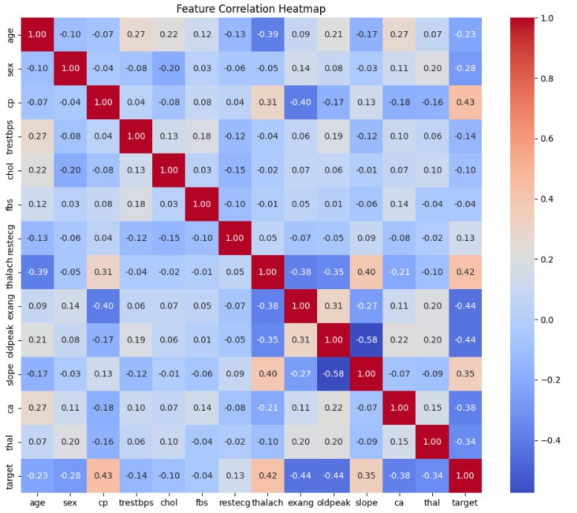

Slide 8
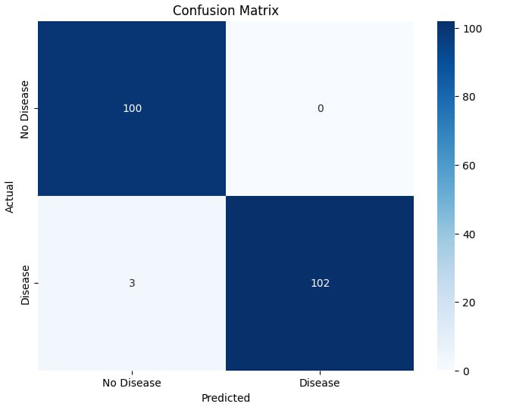
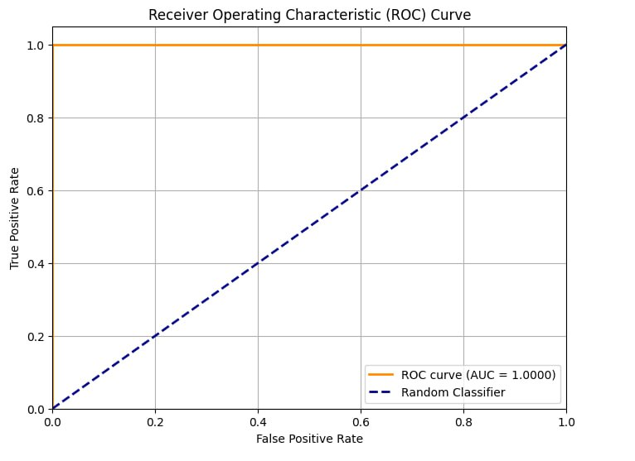

Slide 9
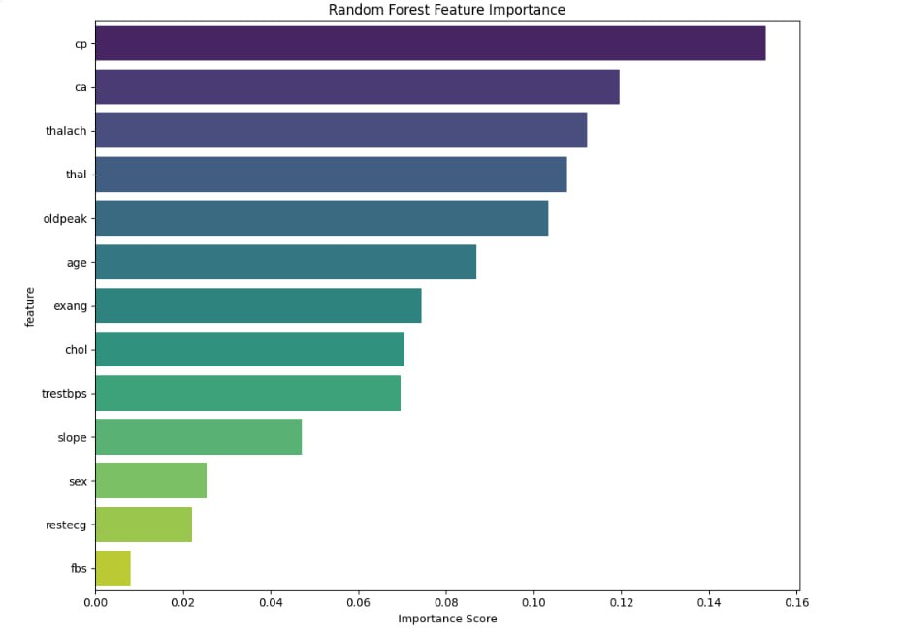
Feature Importance Visualization

